Slide 1
IMOE02:Project Management Credits: 4:0:0:0 Faculty: Sudheer D. Kulkarni

Slide 2
Course objectives:
Students should have an insight about Project Life Cycle, project planning and estimating.
Students should understand the project organization and contracting of project.
Students understand the tools and techniques used in project management.
Students understand the performance measures of project management.
Student understand the risk analysis, financing of projects and venture capital.

Slide 3
Course contents:
Unit I
Concepts of Project Management: Concepts of projects, characteristics of project, Phases of project life cycle, Tools and techniques for project management, Computer based project management.
Project planning and estimating: Feasibility report, Preparation of cost estimation, Evaluation of the project profitability, fixing the zero date.

Slide 4
Unit II
Organization Human Resources and Contracting: Delegation, Skills / abilities required for project manager, Authorities and responsibilities of project manager, Project organization, Contracts, Tendering and Selection of contractors, Team Building.
Unit III
Tools and techniques of project management: Bar (GANTT) chart, Networks, Critical Path Method, Project Evaluation and Review Technique (PERT), Crashing of projects, Resource allocation.

Slide 5
Unit IV
Performance measures in Project Management: Performance indicators, Performance Improvement, Project management and environment.
Risk Analysis: Sources, measures and perspectives on risk, sensitivity analysis, scenario analysis, breakeven analysis, Hiller model, simulation analysis, decision tree analysis, managing risk, project selection under risk, risk analysis in practice.

Slide 6
Unit V
Financing of Projects: Capital structure, menu of financing, equity capital, internal accruals, term loans, debentures, working capital advance, miscellaneous sources, raising of venture capital, raising capital in international markets
Venture Capital: Introduction, VC investment Appraisal Process and Management, The Indian VC industry and regulations, How to approach a VC fund.

Slide 7
References
Project Management: Choudhry S., Tata McGraw-Hill, 2010
Projects: Planning, Analysis, Financing, Implementation, and Review - Prasanna Chandra, 5th edition, Tata McGraw-Hill publishing company limited, 2005
Project management a system approach to planning scheduling and controlling- Harold Kerzner, CBS Publisher and distributors, 2002.
A management guide to PERT and CPM- WEIST and Levy Eastern Economy of PH 2002.
T R Banga, N K Agarwal and S C Sharma -Industrial engineering and Management Sciences, -Khanna Publishers

Slide 8
Concepts of Project Management
Concept of a Project
Examples of projects- Cement projects, refinery projects, methods improvement projects, Lok Sabha election, etc
Organization continuously looks for new business ideas which are technically feasible, economically viable, politically suitable and socially acceptable
To execute these ideas, investment proposal is made, approved and the project begins

Slide 9
Project is initiated to achieve a mission & is completed as soon as the mission is fulfilled
This time span is known as project life cycle
Definition of a project
One shot, time-limited, goal-directed, major undertaking, requiring the commitment of varied skills and resources
A combination of human and non-human resources pooled together in a temporary organization to achieve a specific purpose

Slide 10
Characteristics of a Project:
A project is basically a work
Contributions come from different people but it is recognized as one whole thing (Ex. A book)
Concept of wholeness despite diversities of work
It has to be completed in one shot – once and for all
The project is not complete till the whole thing is complete and performing satisfactorily

Slide 11
Characteristics features of a project
Objectives
Life Span
Single entity
Team Work
Life Cycle
Uniqueness
Change
Successive principle
Made to order
Unity in Diversity
High level of sub-contracting
Risk and uncertainty

Slide 12
Project Family Tree
Plan : National / Corporate with targets for growth
Programme: Heatlth programme, educational programme, science
Project: Power Plants, schools, housing projects
Work Package: Water supply & distribution package, power supply & distribution package
Task: Award of water supply contract, construction of foundations
Activity: Excavation, Laying of cable, preparation of drawing / specifications

Slide 13
Project
National
International
Non-Industrial
Industrial
Non-conventional / R & D
High Technology
Conventional Technology
Low Technology
Mega
Major
Medium
Mini
Grass Root
Expansion
Modification
Normal
Crash
Disaster
Categories of Project

Slide 14
The location, type, technology, size, scope and speed are normally the factors which determine the effort needed in executing a project
Though the characteristics of all the projects are the same, they cannot be treated alike
Categorization based on speed of implementation
Normal Projects
Crash Projects
Disaster Projects

Slide 15
Normal Projects
Minimum capital cost and no sacrifice in terms of quality
Crash Projects
Additional capital costs are incurred to gain time
Maximum overlapping of phases
Compromise on quality may not be ruled out
Disaster Projects
Anything needed to gain time is allowed
No competitive bidding
Very high capital cost, project time drastically reduced

Slide 16
Project Life Cycle Phases
Conception Phase
Definition phase
Planning & organizing phase
Implementation phase
Project clean-up phase
Conception Phase
Project idea germinates
While trying to overcome problems
If this phase is avoided or truncated, the project will have innate defects & may eventually become a liability for the investors

Slide 17
Definition Phase
Develop the idea generated during the conception phase and produce a document describing the project in sufficient details covering all aspects necessary for the customer/financial institution to make up their minds on the project idea
Areas to be examined during this phase:
Raw Materials
Plant Size /Capacity
Location & site
Technology/process selection
Plant layout
Plant & Machinery
Electrical and instrumentation

Slide 18
Civil engineering works
Utilities – fuel, power and water
Manpower and organizational pattern
Financial analysis
Implementation Schedule
Clears some the ambiguities and uncertainties associated with the formation made during the conceptual stage
Establishes the risk involved in going ahead with the project
A project can be accepted or rejected at this stage
A project is said to be born only after it has been cleared for implementation at the end of this phase

Slide 19
Planning and Organizing Phase
Usually overlaps with definition & implementation phases
Project Execution Plan
Activities:
Project infrastructure and enabling services
System design and basic engineering package
Organization and manpower
Schedules & budgets
Licensing and governmental clearances
Finance
Systems and procedure
Identification of project manager

Slide 20
Design basis, general conditions for purchase and contracts
Site preparation and investigation
Construction resource and materials
Implementation Phase
People for the first time can see the project
Common activities
Preparation of specifications for equipment and machinery
Ordering of equipment
Lining up construction contractors
Issue of construction drawing
Civil construction & Equipment foundations
Equipment & machinery erection

Slide 21
Plant electricals
Piping
Instrumentation
Testing, checking, trial run & commissioning
Has a high need for co-ordination and control
Every attempt is made to fast track
Project Clean-up Phase
Transition phase
Drawings, documents, files, operation & maintenance manuals are handed over to customer
Project accounts are closed, material reconciliation carried out, payments are cleared
Project personnel leave the site

Slide 22
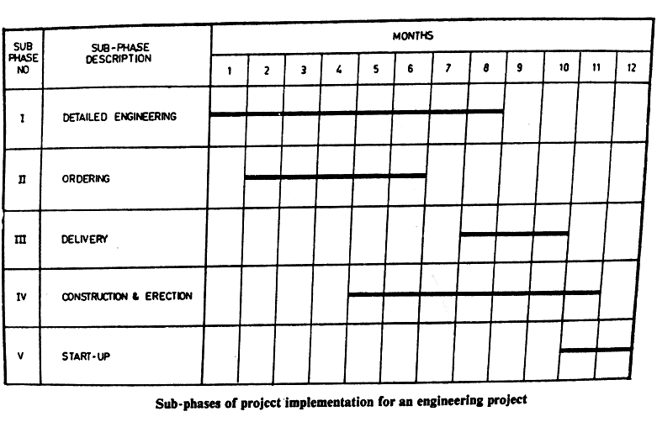

Slide 23
Project Life Cycle Curves
Growth, maturity & decay
Life cycle curve shows the various phases in sequence and the approximate effort involved in each phase
Effort build-up in a project is very slow but effort withdrawal is very sharp
Time taken in the formative & clean-up stages together is more than the implementation stage
The life cycle curve may represent a class of project

Slide 24
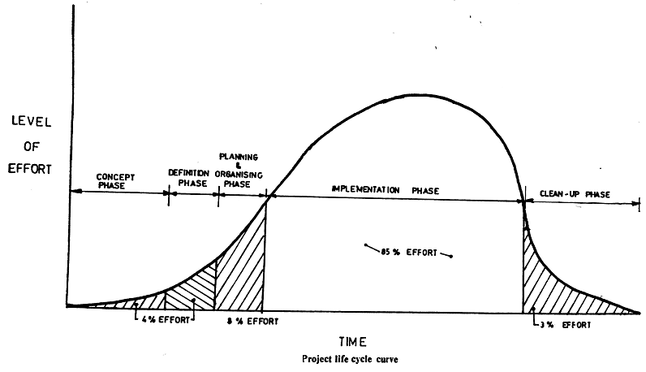

Slide 25
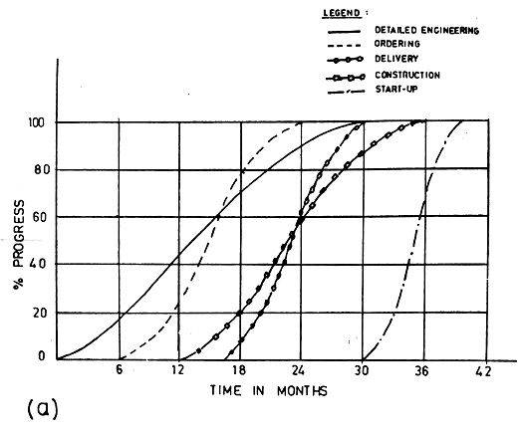

Slide 26
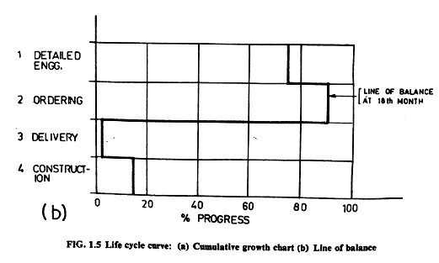

Slide 27
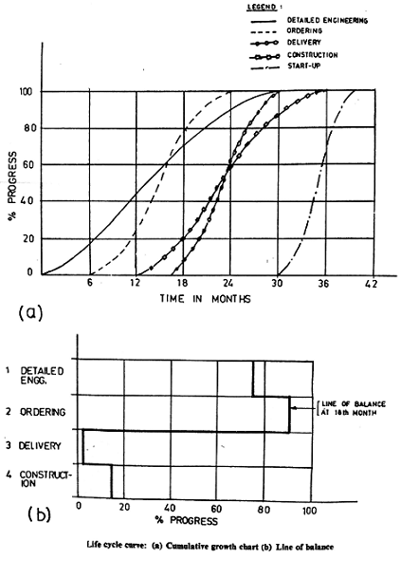

Slide 28
The knowledge of a characteristic life cycle curve enables a project manager to ascertain the state of health of any project at any point of time
Life cycle curve with line of balance
‘S’ curve form represent cumulative growth at any time
If the curves are drawn to indicate the minimum growth required for a sub-phase at any point of time to meet the targeted completion date of a project, then a line of balance can be drawn to indicate the state of health of the project

Slide 29
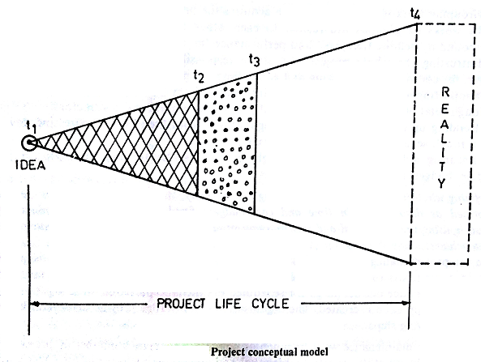

Slide 30
Project Visibility
Cannot be seen for most of its life time
Is vague and fluid, shows no concrete benefits for almost half of the life span
This causes problems for its management
The passage of time will give it a concrete shape
At any point in the life cycle something will be clearly visible, something nearly visible and rest has to be imagined
The full value of the project is realised only at the end

Slide 31
Project Management Concepts
Project is a success if it:
Gets completed
Gets completed within budget
Gets completed within allocated time
Performs to satisfaction
Steps in Project Management
Grouping work into packages which acquires the properties of a project
Entrusting the whole project to a single responsibility known as the project manager
Supporting and servicing the project internally & externally
Building up commitment
Ensuring adherence to goals

Slide 32
Defining what is to be done, maintaining its integrity, and ensuring that it is done and performed as desired, within time & cost budgets fixed for it through a modular work approach, using organizational and extra-organizational resources is what project management has to achieve

Slide 33
Project Management Vs Functional Management
Tools and Techniques for Project Management
Computer Based Project Management System
The Project Manager
Problems of a Project Manager
The scope comes to be clearly known after a passage of long time
No guarantee that the project will maintain its shape and size as it has come to be known

Slide 34
Those who are to complete the project, are almost strangers
Regarding the success criteria there is no previous experience
Roles and Responsibilities of Project Manager
Defining and maintaining the integrity of a project
Development of project execution plan
Organization for execution of the plan
Setting of targets and development of systems and procedures for accomplishment of project objectives & targets

Slide 35
Negotiation for commitments
Direction, co-ordination and control of project activities
Contract management
Non-human resource management including fiscal matters
Projectising and problem solving
Man management
Satisfaction of customer, Government and the public
Achievement of project objectives, cash surplus and higher productivity

Slide 36
Tools and Techniques for Project Management
Project Selection Techniques:
Cost Benefit Analysis
Risk and sensitivity analysis
Project execution planning techniques:
Work breakdown structure (WBS)
Project execution plan (PEP)
Project responsibility matrix
Project management manual

Slide 37
Project Scheduling and coordinating Techniques:
Bar charts
Life cycle curves
Line of Balance (LoB)
Networking techniques (PERT/CPM)
Project monitoring and progressing techniques:
Progress measurement technique (PROMPT)
Performance monitoring technique (PERMIT)
Updating, reviewing and reporting technique

Slide 38
Project Cost and productivity control techniques:
Productivity budgeting technique
Value engineering (VE) and
COST/WBS
Project communication and clean-up techniques:
Control room
Computerized information system

Slide 39
Project Planning & Estimation
Feasibility Report
Feasibility report is prepared to present an in-depth techno-commercial analysis carried out on the project idea for consideration of the financial institutions and other authorities empowered to take the investment decision.

Slide 40
Feasibility report should include:
Raw material survey
Demand survey
Technical study – Product pattern, Process selection, Plant size, Raw material requirements
Location study
Project capital cost estimates and source of finance
Profitability and cash flow analysis
Cost benefit analysis

Slide 41
Raw Material Survey:
Available in natural form
Available as finished product or by-product
Not available in the country
Demand Study:
Demand
Supply
Distribution
Prices

Slide 42
Documents that are usually referred:
Plan documents
Guidelines to industries
Economic survey
Annual survey of industries
Import and export statistics
Monthly bulletin of RBI
Survey reports of various institutions

Slide 43
Technical Study
Product Pattern
Process Selection
Location Study
Availability of Land, Soil Characteristics and Cost of Land
Approach to site
Source of raw material and transportation requirement
Transportation and marketing of finished products
Source and availability of water, power, skilled labour
Tax incentives
Drainage and effluent disposal Facilities
Engineering and maintenance facilities
Acceptance of local bodies

Slide 44
Financing Arrangements
Capital Costs
Costs incurred in the project before it becomes ready to start commercial production
Working Costs
Fund required for maintaining various inventories in the form of raw materials, operating supplies, etc.
Operating Costs
Recurring costs for production, maintenance and marketing, interest on loans

Slide 45
Source of Financing
Internal Sources & External Sources
Short-term financing
Intermediate-term financing
Long-term financing
Financial Structure
Debt capital & Equity capital
Debt equity ratio
A company with high debt is said to be high leverage

Slide 46
Financial Institutions
National Financial Institutions
Industrial Development Bank of India (IDBI)
Industrial Finance Corporation of India (IFCI)
Industrial Credit and Investment Corporation of India (ICICI)
Industrial Reconstruction Corporation of India (IRCI)
State Financial Corporation (SFC)
Life Insurance Corporation (LIC)
Unit Trust of India (UTI)
The Export-Import Bank of India (Exim Bank)

Slide 47
9. The State Industrial Development Corporation (SIDC)
Foreign Financial Institutions
World Bank (International Bank for Reconstruction & Development)
International Finance Corporation (IFC)
International Development Association (IDA)
United Nations Development Programme (UNDP)
International Monetary Fund (IMF)
Asian Development Bank (ADB)
Non-resident Indians (NRI)

Slide 48
Preparation of Cost Estimates
Assessing fund requirement but also for ascertaining the economic viability of the project
One has to repeated estimates at different stages of the project life-cycle so that a workable estimate with reasonable accuracy is available for the purpose for which the estimate is required

Slide 49
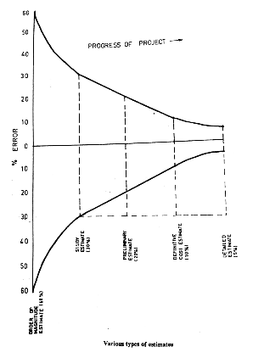

Slide 50
Types of Estimates
Order of magnitude estimate
Study estimate
Preliminary estimate
Definitive estimate
Detailed estimate
Order of Magnitude Estimate
Investment per annual tonne capacity
Turn-over ratio and capital ratio
Six-tenth factor
Inflation index
Location index

Slide 51
Study Estimate
For studying the economic viability of the project
For arranging funds for the project
Preliminary flow sheets, listing of major process equipment with specifications are obtained
Lang Factor: Overall plant cost is estimated by multiplying the total equipment cost by this factor
Error ± 30%

Slide 52
Preliminary Estimate: Error ± 20%
Cost estimates are made successively whenever adequate information, which will ensure further accuracy, is available
This is done when the technology package is frozen and a firm implementation schedule is available
This point of time is considered as an effective start date of zero date of the project
Definitive cost estimate: Error ± 10%
Detailed Estimate: Error ± 5%

Slide 53
Finalization of Project Implementation Schedule
Basis of Time Estimate
Making a work breakdown of the project
Estimating the time schedules for each work
Putting them in proper sequence
Matching their build-up on a time scale with the available resources
The total stretch on the time scale corresponding with the resources sets the target

Slide 54
Time study approach
Previous project data
Guestimating approach
Range estimates
Time taken vs time required
Estimates from vendors and contractors
Allocated and committed time

Slide 55
Evaluation of the Project Profitability
The economic viability of the project can be assessed by the following methods:
Pay Back Period (PBP)
Return on Investment (ROI)
Net Present Value (NPV)
Internal Rate of Return (IRR)
Benefit Cost Ratio (BCR)

Slide 56

Pay Back Period (PBP)
Time required to recover the original investment through incomes from the project
Assuming that the annual income from the project before depreciation but after taxes is uniform

Slide 57

Return on Investment (ROI)
The ratio relates earnings to investment
ROI must be greater than
Bank borrowing rate
Minimum acceptable profitability rate of the company

Slide 58

Net Present Value (NPV)
Previous methods did not consider time value of money
The present value of a future cash flow can be computed as:
Where, PV=present value
S=Cash flow at t year
r=interest rate, also known as discount rate

Slide 59


The factor is known as discount factor
NPV for any project is the aggregate present value of net cash flows over the operating life of the project
Where, NPT=Net present value
S_{t} = net cash flow for the year t
t=operating year
n=operating life of the project
I=original capital investment
r=interest rate
Higher the NPV, better is the project

Slide 60
Internal Rate of Return (IRR)
This is a discounting methods, where instead of assuming a fixed discount rate, the discount rate is varied till the NPV becomes zero
The discount rate at which the net present value becomes zero is know as internal rate of return
Projects with highest IRR will be considered as the best

Slide 61
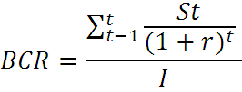
Benefit Cost Ratio (BCR)
Modified form of the NPV method
It is computed as the ratio of aggregate present values of all future cash flows to initial capital investment
Higher the BCR, better is the project
Projects to be accepted must have BCR > 1

Slide 62
Fixing the Zero Date
The project completion period will be counted from this point of time
Pre-project activities
Advance Actions
Infrastructural facilities
Approach road
Power
Water
Railway Siding
Port and Jetty

